Slide 1
CoAP protocol based Libraries & GUI of Toyotomi AC

Slide 2
Associates
Παπαδημητρίου Κ. Γεώργιος 4513
Σκαρτσίλας Κ. Νικόλαος 4628

Slide 3

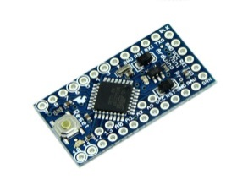
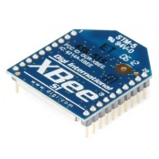
Toyotomi HVAC Remote Control Units
Drupal content module for GUI
Arduino Pro Mini (3.3V, 8MHz)
XBee Rf module (802.15.4)

Slide 4
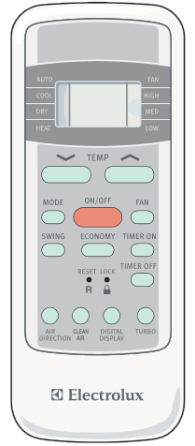





GUI
Mapped Image
Indicators
Segment Display

Slide 5

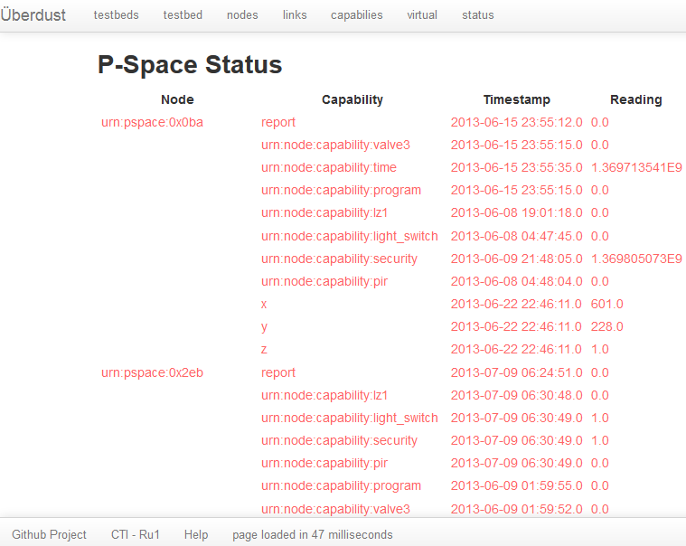
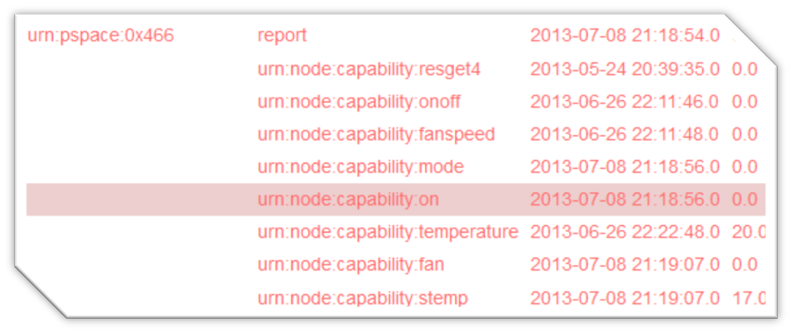
Get Values from Status Page via
$on_off
$mode
$fan
$stemp

Slide 6

Implemented Buttons via
On/Off
Temp Up
Temp Down
Mode
Fan

Slide 7



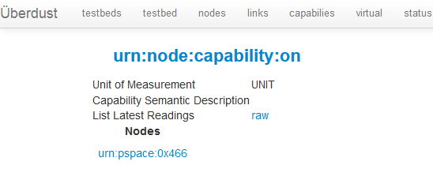

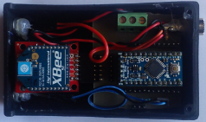

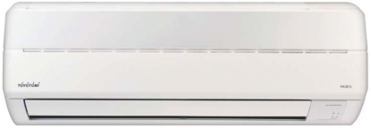


Process
myButtonOnOffSensor.h
void set_value(set_value(uint8_t* input_data, size_t input_data_len, uint8_t* output_data, size_t* output_data_len))
{
if(this->toyo->isPoweredOn()==0)
{
this->toyo->powerOn();//Called 5 times for synchronization reasons
this->toyo->powerOn();
this->toyo->powerOn();
this->toyo->powerOn();
this->toyo->powerOn();
}
else if(this->toyo->isPoweredOn()==1)
{
this->toyo->powerOff();//Called 5 times for synchronization reasons
this->toyo->powerOff();
this->toyo->powerOff();
this->toyo->powerOff();
this->toyo->powerOff();
}
*output_data_len = sprintf( (char*)output_data, "%d", this->toyo->isPoweredOn());
}
$.post();

Slide 8
ON/OFF Operation
On/Off AConoff();

Slide 9


Temp Up Operation
Temp Up incValue();

Slide 10
Temp Down Operation
Temp Down decValue();

Slide 11
Temp Up-Down Implementation
myButtonTempUpDownSensor.h
void set_value(uint8_t* input_data, size_t input_data_len, uint8_t* output_data, size_t* output_data_len)
{
int temper;
if(*input_data=='+')
{
temper=this->toyo->getTemperature()+1;
this->toyo->setTemperature(temper);
}
else if(*input_data=='-')
{
temper=this->toyo->getTemperature()-1;
this->toyo->setTemperature(temper);
}
*output_data_len = sprintf( (char*)output_data, "%d", this->toyo->getTemperature());
}

Slide 12


ModeOperation
Mode buttonMode();
  ACMode();

Slide 13
Mode Implementation
0:AUTO
1:COOL
2:DRY
3:HEAT
4:FAN
myModeSensor.h
void set_value(uint8_t* input_data, size_t input_data_len, uint8_t* output_data, size_t* output_data_len)
{
if(input_data[0]=='0')
{
this->toyo->setMode(AUTO);
}
else if(input_data[0]=='1')
{
this->toyo->setMode(COOL);
}
else if(input_data[0]=='2')
{
this->toyo->setMode(DRY);
}
else if(input_data[0]=='3')
{
this->toyo->setMode(HEAT);
}
else if(input_data[0]=='4')
{
this->toyo->setMode(FAN);
}
*output_data_len = sprintf( (char*)output_data, "%d", this->toyo->getMode());
}

Slide 14
Fan Operation
Fan buttonFan();
ACfanSpeed();

Slide 15
Fan Implementation
0:NONE
1:DEFAULT
2:LOW
3:MED
4:HIGH
mySetFanSpeedSensor.h
void set_value(uint8_t* input_data, size_t input_data_len, uint8_t* output_data, size_t* output_data_len)
{
if(input_data[0]=='0')
{
this->toyo->setFanSpeed(NONE_SP);
}
else if(input_data[0]=='1')
{
this->toyo->setFanSpeed(DEFAULT_SP);
}
else if(input_data[0]=='2')
{
this->toyo->setFanSpeed(LOW_SP);
}
else if(input_data[0]=='3')
{
this->toyo->setFanSpeed(MED_SP);
}
else if(input_data[0]=='4')
{
this->toyo->setFanSpeed(HIGH_SP);
}
*output_data_len = sprintf( (char*)output_data, "%d", this->toyo->getFanSpeed());
}

Slide 16
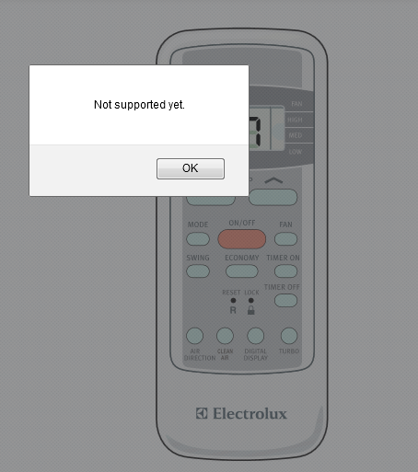
Not supported functions due to the limited memory size of Arduino Pro Mini
AirDirection
CleanAir
LedDisplay
Swing
Turbo

Slide 17
THANK YOU

